Slide 1
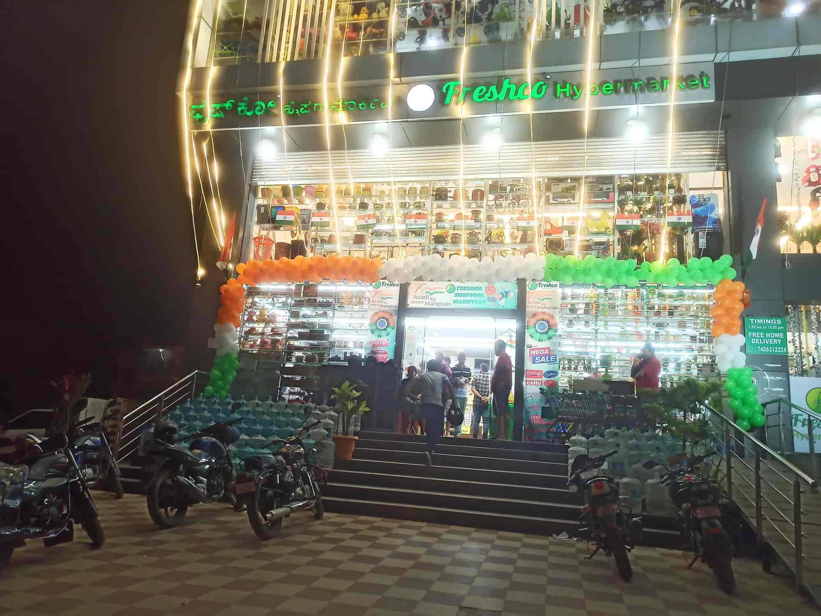
Freshco Hypermarket - Enhancing Customer Convenience
HSR, Bangalore
Freshco Hypermarket: Optimizing Home Delivery Service
Order Level Analysis, Customer Level Analysis, Delivery Analysis Completion Rate Analysis

Slide 2
Overview of Home Delivery Service :
Due to the development of e-commerce and specific customer habits and requirements, in recent decades an increasing number of companies offer home delivery service
It implies maximum convenience for buyers in theory — and customer expectations are only growing
Most of the packages are delivered during the regular working hours when recipients are frequently absent from their homes.

Slide 3
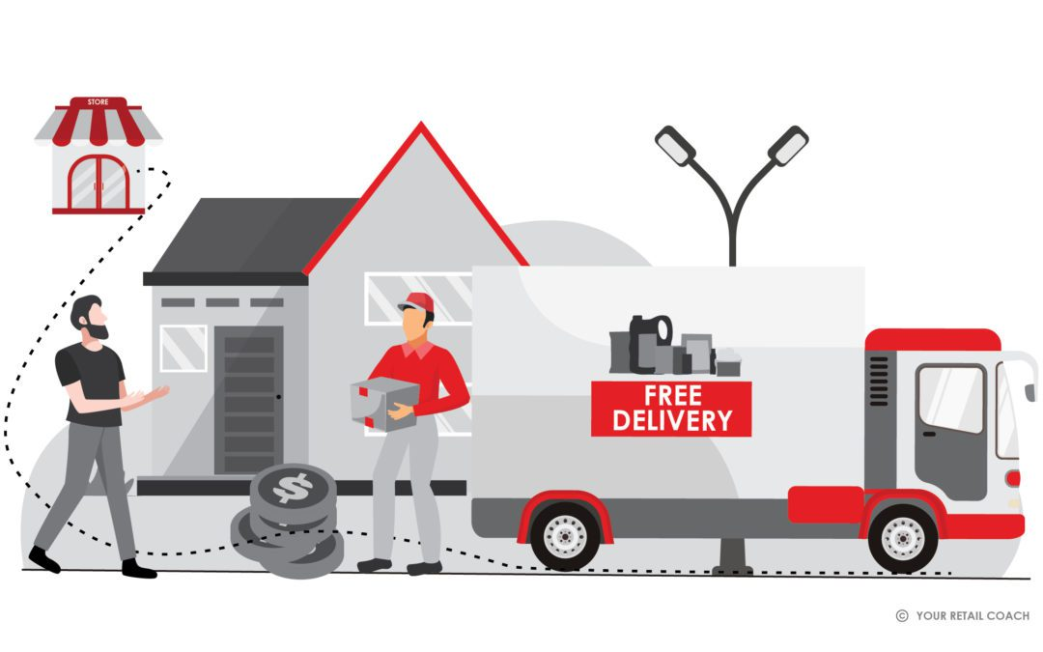
Motivation behind introducing home delivery Highlight the year of introduction (2021)
Since groceries are essential, people have no other option but to continue making this routine purchase despite the lockdown restrictions. In India, even though grocery stores were allowed to remain open under stipulations, online grocery shopping has witnessed a tremendous spike. This also resulted in a proportionate rise in demand for home delivery services.

Slide 4
Specific features that make the service stand out:
Extensive Product Range
Competitive Pricing
One-stop Shopping
Fresh Produce Section
In-House Brands
Special Offers and Promotions
Convenience Services
Customer-Friendly Layout
Customer Base

Slide 5
Now Discuss the importance of maintaining a comprehensive transaction data sheet Emphasize its role in ensuring seamless operations and optimizing customer satisfaction
Order Level Analysis
Completion Rate Analysis
Customer Level Analysis
Delivery Analysis

Slide 6
Order level analysis: Order level analysis in a hypermarket like Freshco involves examining various aspects related to the ordering process, inventory management, and overall supply chain efficiency. Here are key components that may be included in an order level analysis for a hypermarket. Here are key components that may be included in an order level analysis for a hypermarket.
Demand Forecasting:
Analyzing historical sales data to predict future demand.
Utilizing tools and algorithms to forecast demand for different product categories.
Inventory Management:
Evaluating stock levels to ensure products are available to meet customer demand.
Minimizing excess inventory to avoid overstock situations.
Supplier Performance:
Assessing the reliability and efficiency of suppliers in delivering products on time.
Analyzing lead times and order fulfillment accuracy.
Ordering Processes:
Examining the efficiency of the order placement and processing systems.
Identifying any bottlenecks or delays in the ordering workflow.
Technology Integration:
Leveraging technology such as advanced inventory management systems and automated ordering systems.
Ensuring seamless integration between the ordering system and other business processes.

Slide 7
Order level analysis:
Seasonal Variation:
Considering seasonal variations in demand and adjusting ordering strategies accordingly.
Managing promotions and discounts effectively to optimize inventory levels.
Customer Preferences:
Analyzing customer buying patterns to optimize stock levels for popular items.
Understanding customer preferences to tailor product offerings.
Waste Reduction:
Implementing strategies to minimize waste, especially for perishable goods.
Monitoring expiration dates and managing clearance sales effectively.
Cost Optimization:
Evaluating the cost-effectiveness of ordering processes and transportation.
Negotiating favorable terms with suppliers and optimizing logistics costs.
Data Analytics:
Utilizing data analytics tools to gain insights into customer behavior, product performance, and market trends.
Making data-driven decisions to enhance the efficiency of ordering processes.
Continuous Improvement:
Implementing a continuous improvement mindset, regularly reviewing and refining ordering processes.
Seeking feedback from stakeholders and incorporating improvements accordingly.

Slide 8
Home delivery service in the year 2021 Order Level Analysis in Table and Chart Order distribution at slot and delivery area levels
Row Labels | Count of order distribution at delivery area level
Afternoon | 5924
Evening | 4712
Late Night | 1589
Morning | 5389
Night | 5209
Grand Total | 22823

Slide 9
Home delivery service in the year 2021: Order Level Analysis in Table and Chart Order Distribution at Areas with the highest increase in monthly orders (from January to September) in absolute orders.
Count of Order Date | Column Labels
Row Labels | Jan | Feb | Mar | Apr | May | Jun | Jul | Aug | Sep | Grand Total
Akshaya Nagar |  | 0 | 3 | 2 | -1 | 2 | -6 | 1 | 1
Arekere |  | -2 | 0 | 1 | 0 | 0 | -1 | 0 | 1
Banashankari Stage 2 |  | 0 | 0 | 0 | 0 | 1 | 0 | -1 | 0
Bannerghatta |  | -2 | 1 | -1 | 1 | -1 | 0 | 1 | -1
Basavanagudi |  | 0 | 0 | 0 | 3 | -3 | 0 | 0 | 0
Bellandur - Off Sarjapur Road |  | -3 | 3 | 5 | -1 | -2 | -4 | 5 | -4
Bellandur, APR |  | 6 | -3 | -4 | -1 | 1 | -1 | 3 | -3
Bellandur, Ecospace |  | -1 | 0 | 0 | 0 | 0 | 0 | 0 | 0
Bellandur, ETV |  | 0 | 1 | -1 | 0 | 0 | 0 | 0 | 1
Bellandur, Green Glen |  | 0 | 2 | 6 | 0 | 6 | 0 | -12 | 12
Bellandur, Sakara |  | 0 | 1 | 0 | 2 | -2 | 0 | 1 | 0
Bellandur, Sarjapur Road |  | -6 | 3 | 7 | -6 | 10 | -5 | -8 | 5
Bilekahalli |  | -2 | 1 | -1 | 2 | -2 | 2 | -1 | 2
Binnipet |  | 0 | 0 | 0 | 0 | 0 | 1 | -1 | 0
Bomannahali - MicoLayout |  | -45 | 4 | 9 | -8 | 15 | 0 | 14 | -29
Bommanahalli |  | 0 | -2 | 0 | 8 | -7 | -3 | 1 | -2
Brookefield |  | 0 | 0 | 0 | 0 | 0 | 1 | -1 | 0
BTM Stage 1 |  | 1 | 2 | -2 | 5 | -7 | -1 | 2 | 0
BTM Stage 2 |  | 0 | -1 | 0 | 3 | -5 | 2 | 0 | 2
Challagatta |  | 0 | 0 | 0 | 0 | 0 | 0 | 1 | -1
Cox Town |  | 0 | 0 | 0 | 0 | 0 | 1 | -1 | 0
CV Raman Nagar |  | 0 | 0 | 0 | 0 | 1 | -1 | 0 | 0
Devarachikanna Halli |  | 1 | -1 | 1 | -2 | 1 | -1 | 0 | 1
Doddanekundi |  | 0 | 0 | 0 | 0 | 0 | 1 | 0 | -1
Domlur, EGL |  | -2 | 1 | 1 | 0 | -2 | 0 | 0 | 1
Frazer Town |  | 0 | 1 | -1 | 0 | 0 | 0 | 0 | 0
Harlur |  | 17 | 18 | -2 | -18 | -1 | 17 | 170 | 285
HSR Layout |  | 114 | 387 | 221 | -26 | 87 | 27 | 39 | 685
Indiranagar |  | 0 | 0 | 3 | -1 | -1 | 1 | -2 | 0
ITI Layout |  | -11 | 98 | 23 | -20 | 84 | 29 | 61 | 389
Jayanagar |  | -1 | 0 | 0 | 0 | 0 | 1 | 0 | -1
JP Nagar Phase 1-3 |  | -1 | 1 | 0 | 0 | -1 | 0 | 1 | -1
JP Nagar Phase 4-5 |  | 0 | -1 | 1 | 2 | -3 | 0 | 1 | -1
JP Nagar Phase 6-7 |  | 1 | 0 | -1 | 3 | -2 | -1 | 0 | 0
JP Nagar Phase 8-9 |  | 0 | 0 | 0 | 0 | 1 | -1 | 0 | 0
Kadubeesanhali, Prestige |  | 1 | 1 | -2 | 2 | -2 | 3 | -3 | 1
Kadubeesanhali, PTP |  | 0 | 0 | 0 | 1 | -1 | 0 | 0 | 0
Koramangala, Ejipura |  | 10 | -4 | 24 | -2 | -12 | -6 | -7 | 9
Kudlu |  | -9 | 5 | -2 | 29 | 22 | -43 | -3 | -26
Kumaraswamy Layout |  | 1 | -1 | 0 | 2 | -2 | 1 | -1 | 0
Mahadevapura |  | 0 | 0 | 0 | 1 | -1 | 0 | 0 | 0
Manipal County |  | -9 | 2 | 3 | -1 | 16 | -16 | 3 | -5
Marathahalli |  | -1 | 0 | 0 | 1 | -1 | 0 | 0 | 1
Pattandur |  | 0 | 0 | 0 | 0 | 0 | 0 | 1 | -1
Richmond Town |  | 0 | 0 | 0 | 2 | -2 | 0 | 0 | 0
Sarjapur Road |  | -1 | 0 | 1 | 5 | -2 | 0 | -4 | 4
Victoria Layout |  | 0 | 0 | 0 | 0 | 0 | 0 | 0 | 1
Vimanapura |  | 0 | 0 | 0 | 1 | -1 | 0 | 0 | 0
Viveka Nagar |  | 0 | 0 | 1 | 2 | -2 | 1 | -2 | 0
Whitefield |  | 0 | 0 | 0 | 0 | 0 | 0 | 0 | 1
Wilson Garden, Shantinagar |  | 0 | 1 | -1 | 1 | -1 | 0 | 0 | 2
Yemalur |  | 1 | -1 | 1 | -1 | 1 | 0 | 1 | -1
Grand Total |  | 57 | 522 | 292 | -12 | 182 | -2 | 259 | 1327

Slide 10
Home delivery service in the year 2021: Order Level Analysis in Table and Chart Order Distribution at Delivery Charges as a Percentage of Product Amount at Slot and Month Level.
Sum of delivery charges | Column Labels
Row Labels | Jan | Feb | Mar | Apr | May | Jun | Jul | Aug | Sep | Grand Total
Afternoon | 9.3% | 7.8% | 7.5% | 7.8% | 4.9% | 5.2% | 4.3% | 2.6% | 1.7% | 5.1%
Evening | 10.2% | 8.7% | 8.3% | 8.0% | 5.6% | 5.4% | 5.1% | 2.2% | 1.7% | 5.4%
Late Night | 15.9% | 17.0% | 15.9% | 15.6% | 4.4% | 12.7% | 12.9% | 7.7% | 5.6% | 12.3%
Morning | 10.8% | 10.1% | 8.5% | 7.9% | 4.9% | 4.7% | 5.1% | 2.8% | 1.9% | 5.3%
Night | 10.8% | 10.0% | 8.9% | 9.4% | 6.5% | 6.4% | 6.7% | 2.8% | 2.2% | 6.4%
Grand Total | 10.7% | 9.7% | 9.0% | 8.6% | 5.3% | 5.5% | 5.7% | 2.9% | 2.1% | 5.9%

Slide 11
Home delivery service in the year 2021: Order Level Analysis in Table and Chart Order Distribution at Discount as a percentage of product amount at slot and month level
Sum of Discount percentage | Column Labels
Row Labels | Jan | Feb | Mar | Apr | May | Jun | Jul | Aug | Sep | Grand Total
Afternoon | 1.0% | 0.4% | 0.9% | 1.0% | 4.8% | 2.4% | 4.8% | 21.5% | 10.5% | 6.4%
Evening | 1.2% | 0.4% | 0.6% | 0.6% | 4.5% | 1.9% | 5.9% | 20.6% | 11.5% | 6.5%
Late Night | 0.7% | 0.6% | 0.6% | 0.6% | 3.4% | 1.9% | 3.3% | 12.8% | 5.1% | 3.7%
Morning | 0.9% | 1.1% | 0.6% | 0.7% | 4.1% | 1.7% | 4.6% | 20.9% | 11.0% | 6.5%
Night | 1.0% | 0.8% | 0.6% | 0.9% | 5.1% | 1.9% | 6.7% | 22.1% | 9.8% | 6.8%
Grand Total | 1.0% | 0.7% | 0.7% | 0.8% | 4.6% | 2.0% | 5.3% | 20.8% | 10.4% | 6.4%

Slide 12
Home delivery service in the year 2021: Order Level Analysis in Table and Chart Order at a discount as a percentage of the product amount at the drop-off area and slot level.
Sum of Discount percentages at slot and PA | Column Labels
Row Labels | Afternoon | Evening | Late Night | Morning | Night | Grand Total
Akshaya Nagar | 0.002866356 | 0.002541 | 0 | 0.001761 | 0.104827 | 0.014858
Arekere | 0 | 0.016949 | 0 | 0 | 0.030568 | 0.008225
Banashankari Stage 2 | 0 | 0 | 0 | 0 | 0 | 0
Bannerghatta | 0 | 0.019504 | 0 | 0 | 0.077163 | 0.025685
Basavanagudi | 0 | 0 | 0 | 0 | 0 | 0
Bellandur - Off Sarjapur Road | 0.050126217 | 0.041766 | 0 | 0.018018 | 0.142254 | 0.074555
Bellandur, APR | 0.040885609 | 0.029605 | 0 | 0.01094 | 0.066667 | 0.029392
Bellandur, Ecospace | 0 | 0 | 0 | 0 | 0 | 0
Bellandur, ETV | 0 | 0 | 0 | 0 | 0 | 0
Bellandur, Green Glen | 0.046692885 | 0.058257 | 0.0422187 | 0.022259 | 0.061356 | 0.046499
Bellandur, Sakara | 0.01492983 | 0 | 0.4323144 | 0 | 0 | 0.03125
Bellandur, Sarjapur Road | 0.007111031 | 0.017364 | 0.0124577 | 0.022835 | 0.009926 | 0.011443
Bilekahalli | 0.132515337 | 0.01657 | 0.1 | 0.131519 | 0.297297 | 0.077719
Binnipet | 0 | 0 | 0 | 0 | 0 | 0
Bomannahali - MicoLayout | 0.021487151 | 0.02674 | 0.0211078 | 0.037263 | 0.068201 | 0.035143
Bommanahalli | 0.018961253 | 0.028577 | 0.0443038 | 0.012243 | 0.033267 | 0.023068
Brookefield | 0 | 0 | 0 | 0 | 0 | 0
BTM Stage 1 | 0.146874368 | 0 | 0 | 0.082136 | 0.006755 | 0.065171
BTM Stage 2 | 0.005263158 | 0.088263 | 0 | 0.048753 | 0.018409 | 0.041276
Challagatta | 0 | 0 | 0 | 0 | 0 | 0
Cox Town | 0 | 0 | 0 | 0 | 0 | 0
CV Raman Nagar | 0 | 0 | 0 | 0 | 0 | 0
Devarachikanna Halli | 0.011627907 | 0 | 0 | 0 | 0.124228 | 0.061944
Doddanekundi | 0 | 0 | 0 | 0 | 0.1 | 0.033333
Domlur, EGL | 0 | 0 | 0.1708633 | 0.013081 | 0 | 0.033504
Frazer Town | 0 | 0 | 0 | 0 | 0 | 0
Harlur | 0.103118749 | 0.092412 | 0.0369523 | 0.101701 | 0.098968 | 0.097028
HSR Layout | 0.062110194 | 0.065306 | 0.0396011 | 0.060091 | 0.065187 | 0.061959
Indiranagar | 0.01584343 | 0 | 0 | 0 | 0.067633 | 0.028422
ITI Layout | 0.072091789 | 0.070856 | 0.0411268 | 0.08209 | 0.07972 | 0.073612
Jayanagar | 0 | 0.356115 | 0 | 0 | 0 | 0.055649
JP Nagar Phase 1-3 | 0 | 0.166948 | 0 | 0 | 0 | 0.063543
JP Nagar Phase 4-5 | 0 | 0 | 0.2066806 | 0.002662 | 0 | 0.018056
JP Nagar Phase 6-7 | 0 | 0 | 0 | 0.002028 | 0 | 0.001358
JP Nagar Phase 8-9 | 0 | 0.004146 | 0 | 0 | 0 | 0.004146
Kadubeesanhali, Prestige | 0 | 0 | 0 | 0 | 0.019342 | 0.002481
Kadubeesanhali, PTP | 0 | 0 | 0 | 0 | 0 | 0
Koramangala, Ejipura | 0.068831466 | 0.057383 | 0.0205208 | 0.013149 | 0.030085 | 0.041757
Kudlu | 0.063637977 | 0.036598 | 0.0143698 | 0.04875 | 0.046868 | 0.047626
Kumaraswamy Layout | 0 | 0 | 0 | 0 | 0 | 0
Mahadevapura | 0 | 0 | 0 | 0 | 0 | 0
Manipal County | 0.035326319 | 0.033234 | 0.0585774 | 0.045738 | 0.12419 | 0.04882
Marathahalli | 0 | 0 | 0 | 0 | 0 | 0
Pattandur | 0 | 0 | 0 | 0 | 0 | 0
Richmond Town | 0 | 0 | 0 | 0 | 0 | 0
Sarjapur Road | 0.001295337 | 0 | 0 | 0 | 0.023457 | 0.010912
Victoria Layout | 0 | 0 | 0 | 0 | 0.070707 | 0.070707
Vimanapura | 0 | 0 | 0 | 0 | 0 | 0
Viveka Nagar | 0.005813953 | 0.003026 | 0 | 0 | 0 | 0.004602
Whitefield | 0 | 0 | 0 | 0 | 0 | 0
Wilson Garden, Shantinagar | 0 | 0.022472 | 0 | 0 | 0.038095 | 0.030928
Yemalur | 0 | 0.098765 | 0 | 0.121771 | 0 | 0.069142
Grand Total | 0.0637256 | 0.064884 | 0.0372638 | 0.064506 | 0.068192 | 0.063732

Slide 13
Customer Level analysis: Hypermarket involves a detailed examination of customer behavior, preferences, and satisfaction specific to the home delivery experience. Here are key elements to consider in such an analysis
Ordering Patterns:
Analyzing the frequency and consistency of home delivery orders from individual customers.
Identifying peak ordering times and adjusting resources accordingly.
Product Preferences:
Understanding the types of products customers prefer for home delivery.
Tailoring promotions and offerings based on customer purchasing history.
Delivery Time Preferences:
Examining customer preferences for delivery time slots.
Offering flexible delivery options and optimizing delivery routes for efficiency.
User Experience on Online Platforms:
Evaluating the usability and efficiency of the online ordering platform.
Identifying any issues that may impact the customer's ability to place orders seamlessly.
Customer Feedback and Reviews:
Collecting and analyzing customer feedback and reviews related to the home delivery service.
Addressing any concerns or issues raised by customers to enhance satisfaction

Slide 14
Customer Level analysis:
Loyalty Program Participation:
Analyzing customer participation in loyalty programs related to home delivery.
Encouraging repeat business through tailored incentives and rewards.
Order Accuracy and Timeliness:
Assessing the accuracy of delivered orders and the timeliness of deliveries.
Implementing measures to minimize errors and enhance delivery speed.
Communication Effectiveness:
Examining the effectiveness of communication with customers regarding order confirmations, delivery updates, and any issues that may arise.
Ensuring clear and timely communication through various channels.
Promotion and Marketing Impact:
Evaluating the success of promotions and marketing efforts related to the home delivery service.
Adjusting promotional strategies based on customer response.
Customer Retention Strategies:
Developing and implementing strategies to retain home delivery customers, such as personalized offers and exclusive benefits.

Slide 15
Home delivery service in the year 2021: customer level analysis in Table and Chart completion rate at source level
Row Labels | Sum of Completion Rate
Facebook | 0.114226876
Google | 0.233273452
Instagram | 0.121324979
Offline Campaign | 0.124698769
Organic | 0.291591815
Snapchat | 0.110414932
Grand Total | 0.995530824

Slide 16
Home delivery service in the year 2021: customer level analysis in Chart LTV for every customer

Slide 17
Home delivery service in the year 2021: customer-level analysis in Table and Chart Aggregated LTV at the customer acquisition source level
Row Labels | Average of Aggregated LTV
Facebook | ₹ 373.08
Google | ₹ 383.07
Instagram | ₹ 349.11
Offline Campaign | ₹ 373.05
Organic | ₹ 362.73
Snapchat | ₹ 389.48
Grand Total | ₹ 371.28

Slide 18
Home delivery service in the year 2021: customer-level analysis in Chart Aggregated LTV at acquisition month level

Slide 19
Home delivery service in the year 2021: customer-level analysis in Table and Chart Aggregated LTV at Average Revenue per Order at Different Customer Acquisition Sources
Row Labels | Average of Total Delivery
Facebook | ₹ 328.10
Google | ₹ 342.55
Instagram | ₹ 301.10
Offline Campaign | ₹ 326.01
Organic | ₹ 323.56
Snapchat | ₹ 344.16
Grand Total | ₹ 328.38

Slide 20
Home delivery service in the year 2021: customer-level analysis in Table and Chart Average Revenue per Order at Acquisition Month Level
Row Labels | Average of Total Delivery
Jan | ₹ 331.30
Feb | ₹ 334.48
Mar | ₹ 324.18
Apr | ₹ 346.09
May | ₹ 380.52
Jun | ₹ 344.65
Jul | ₹ 340.04
Aug | ₹ 311.84
Sep | ₹ 280.20
Grand Total | ₹ 328.38

Slide 21
Home delivery service in the year 2021: customer-level analysis in Table and Chart Order rating across slots and delivery charges
Sum of Delivery Charges | Column Labels
Row Labels | Afternoon | Evening | Late Night | Morning | Night | Grand Total
1 | ₹ 505.00 | ₹ 686.00 | ₹ 452.00 | ₹ 747.00 | ₹ 909.00 | ₹ 3,299.00
2 | ₹ 165.00 | ₹ 162.00 | ₹ 171.00 | ₹ 242.00 | ₹ 340.00 | ₹ 1,080.00
3 | ₹ 1,895.00 | ₹ 1,001.00 | ₹ 460.00 | ₹ 915.00 | ₹ 1,104.00 | ₹ 5,375.00
4 | ₹ 4,809.00 | ₹ 4,442.00 | ₹ 1,641.00 | ₹ 5,341.00 | ₹ 5,659.00 | ₹ 21,892.00
5 | ₹ 77,811.00 | ₹ 64,099.00 | ₹ 32,680.00 | ₹ 69,539.00 | ₹ 70,900.00 | ₹ 3,15,029.00
(blank) | ₹ 28,549.00 | ₹ 23,504.00 | ₹ 15,581.00 | ₹ 25,089.00 | ₹ 29,548.00 | ₹ 1,22,271.00
Grand Total | ₹ 1,13,734.00 | ₹ 93,894.00 | ₹ 50,985.00 | ₹ 1,01,873.00 | ₹ 1,08,460.00 | ₹ 4,68,946.00

Slide 22
Delivery Analysis : A Delivery Analysis Overview in a hypermarket involves assessing and optimizing the processes related to the delivery of goods to customers. This analysis aims to enhance efficiency, customer satisfaction, and overall operational performance. Here is an overview of key aspects to consider
Order Processing:
Evaluate the effectiveness of order processing systems. Ensure that orders are accurately recorded and transmitted to the delivery team.
Assess the speed and accuracy of order confirmation, including any notifications to customers.
Inventory Management:
Analyze inventory levels and turnover to prevent stockouts or overstock situations.
Implement real-time inventory tracking systems to enhance accuracy and minimize errors in picking and packing.
Delivery Timeframes:
Measure and optimize delivery times. Consider setting realistic delivery timeframes to manage customer expectations.
Evaluate peak delivery hours and days to allocate resources effectively.
Route Optimization:
Use technology to optimize delivery routes, minimizing travel time and fuel costs.
Implement route tracking and monitoring systems to ensure drivers follow the planned routes.
Communication with Customers:
Establish clear communication channels with customers, providing real-time updates on their orders and delivery status.
Collect feedback from customers to identify areas for improvement in the delivery process.

Slide 23
Delivery Analysis:
Quality Control:
Implement checks and quality control measures to ensure that products are delivered in good condition.
Monitor and address any customer complaints related to product quality or condition upon delivery.
Cost Efficiency:
Analyze the costs associated with the delivery process, including transportation, labor, and technology investments.
Identify opportunities for cost savings without compromising service quality.
Technology Integration:
Integrate advanced technology solutions such as GPS tracking, automated order processing, and inventory management systems.
Explore the use of analytics to gain insights into delivery patterns and customer preferences.
Staff Training:
Train delivery staff on customer service, time management, and the proper handling of products.
Implement continuous training programs to keep staff updated on the latest industry trends and technologies.
Sustainability:
Consider environmentally friendly delivery options and packaging to align with sustainability goals.
Evaluate the environmental impact of the delivery process and explore ways to reduce the carbon footprint.

Slide 24
Home delivery service in the year 2021: Delivery Analysis in Table and Chart Average overall delivery time per month and delivery area level.
Average of Overall delivery time | Column Labels
Row Labels | Jan | Feb | Mar | Apr | May | Jun | Jul | Aug | Sep | Grand Total
Akshaya Nagar |  |  | 1.038140432 | 1.034164352 | 1.043185764 | 1.034938272 |  | 1.072638889 | 0.525439815 | 0.990054012
Arekere | 1.0196354 |  |  | 1.036099537 | 1.038900463 | 1.03693287 |  |  | 1.023460648 | 1.029110725
Banashankari Stage 2 |  |  |  |  |  | 1.017314815 | 1.03775463 |  |  | 1.027534722
Bannerghatta | 1.036689815 |  | 1.027905093 |  | 1.042106481 |  |  | 1.039664352 |  | 1.036611111
Basavanagudi |  |  |  |  | 1.040138889 |  |  |  |  | 1.040138889
Bellandur - Off Sarjapur Road | 1.024502315 | 1.010590278 | 1.024956597 | 1.028414352 | 1.035840567 | 1.020812114 | 1.022326389 | 1.019495701 | 1.021161265 | 1.0254627
Bellandur, APR | 1.034371142 | 1.029215535 | 1.030244985 | 1.036614583 | 1.023923611 | 1.028009259 | 1.031724537 | 1.032375579 | 1.028831019 | 1.030715597
Bellandur, Ecospace | 1.014791667 |  |  |  |  |  |  |  |  | 1.014791667
Bellandur, ETV |  |  | 1.010555556 |  |  |  |  |  | 1.020555556 | 1.015555556
Bellandur, Green Glen | 0.89473235 | 1.016971933 | 1.022341435 | 1.024827112 | 1.035352286 | 1.018834701 | 1.018478535 | 1.021575231 | 0.926589857 | 0.999265219
Bellandur, Sakara |  |  | 1.034571759 | 1.043368056 | 1.049502315 | 1.017962963 | 1.019571759 | 1.02505787 | 1.014699074 | 1.031226852
Bellandur, Sarjapur Road | 1.022078072 | 1.019759259 | 1.022408854 | 0.95830787 | 1.044275977 | 0.965833942 | 0.94947834 | 1.018063272 | 1.018837332 | 0.992379181
Bilekahalli | 1.02572338 |  | 1.0371875 |  | 1.030543981 |  | 1.034247685 | 1.01681713 | 1.019479167 | 1.026679293
Binnipet |  |  |  |  |  |  | 1.032280093 |  |  | 1.032280093
Bomannahali - MicoLayout | 1.010447659 | 1.021460134 | 0.999749858 | 1.005884219 | 1.041160417 | 1.023600249 | 1.019608084 | 1.020688877 | 0.917211111 | 1.008342219
Bommanahalli | 1.022261905 | 1.017331349 | 1.023430556 | 1.028328704 | 1.044552172 | 1.020597994 | 1.02494213 | 1.02729456 | 1.01041088 | 1.027760417
Brookefield |  |  |  |  |  |  | 1.063344907 |  |  | 1.063344907
BTM Stage 1 | 1.020852623 | 1.017291667 | 1.02546875 | 1.025121528 | 1.027719907 | 1.018043981 | 1.031550926 | 1.021651235 | 0.682951389 | 0.994741402
BTM Stage 2 | 1.020081019 | 1.018098958 | 0.352561728 | 1.020520833 | 1.033690201 | 1.017638889 | 0.695011574 | 1.026840278 | 1.023381944 | 0.930444155
Challagatta |  |  |  |  |  |  |  | 1.028553241 |  | 1.028553241
Cox Town |  |  |  |  |  |  | 1.002199074 |  |  | 1.002199074
CV Raman Nagar |  |  |  |  |  | 1.044409722 |  |  |  | 1.044409722
Devarachikanna Halli | 0.017731481 | 1.029797454 | 1.032662037 | 1.045648148 |  | 1.018634259 |  |  | 1.025636574 | 0.905694444
Doddanekundi |  |  |  |  |  |  | 1.02681713 | 1.029259259 |  | 1.028038194
Domlur, EGL | 1.013443287 |  | 1.005335648 | 1.030271991 | 1.067534722 |  |  |  | 0.024421296 | 0.906532118
Frazer Town |  |  | 0.031111111 |  |  |  |  |  |  | 0.031111111
Harlur | 1.021117662 | 0.918546462 | 0.973199837 | 1.011867329 | 1.041744281 | 1.019237666 | 0.994664765 | 1.008404555 | 1.018616544 | 1.007584502
HSR Layout | 1.004509905 | 1.001315736 | 1.000819324 | 1.01228008 | 1.029222207 | 1.011544755 | 1.003671614 | 1.00165452 | 1.001669669 | 1.007487653
Indiranagar |  |  |  | 1.04787037 | 1.037905093 | 1.026284722 | 1.01744213 |  |  | 1.035073785
ITI Layout | 1.000223765 | 0.989258299 | 0.985737278 | 1.008025259 | 1.030921708 | 1.011587049 | 0.992479206 | 1.007448048 | 1.005546973 | 1.004273948
Jayanagar | 1.038935185 |  |  |  |  |  | 1.036828704 | 1.037465278 |  | 1.037743056
JP Nagar Phase 1-3 | 1.022777778 |  | 0.041412037 | 1.026828704 | 1.039861111 |  |  | 1.028680556 |  | 0.831912037
JP Nagar Phase 4-5 | 1.026226852 | 1.03900463 |  | 1.031585648 | 1.038834877 |  |  | 0.036585648 |  | 0.892843915
JP Nagar Phase 6-7 |  | 1.034097222 | 0.022488426 |  | 1.037349537 | 1.031215278 |  |  |  | 0.86664159
JP Nagar Phase 8-9 |  |  |  |  |  | 1.041296296 |  |  |  | 1.041296296
Kadubeesanhali, Prestige |  | 0.024861111 | 0.519114583 |  | 1.044108796 |  | 0.69939429 |  | 1.014583333 | 0.69600823
Kadubeesanhali, PTP |  |  |  |  | 1.029560185 |  |  |  |  | 1.029560185
Koramangala, Ejipura | 1.018574074 | 0.951106481 | 1.018219697 | 1.030529431 | 1.037783039 | 0.973837081 | 0.686283179 | 1.019239005 | 1.015834695 | 0.981519893
Kudlu | 1.002207702 | 0.976266606 | 0.982160948 | 1.025564295 | 1.038370281 | 1.000821528 | 1.002750569 | 1.022330247 | 0.946187583 | 1.004446813
Kumaraswamy Layout |  | 1.03724537 |  |  | 1.04056713 |  | 1.039953704 |  |  | 1.039583333
Mahadevapura |  |  |  |  | 1.101840278 |  |  |  |  | 1.101840278
Manipal County | 0.940814043 | 1.021354167 | 1.024402778 | 0.905034722 | 1.043333333 | 1.024246679 | 0.744237765 | 1.023664352 | 1.026356481 | 0.976940249
Marathahalli | 1.022638889 |  |  |  | 1.034571759 |  |  |  | 1.020625 | 1.025945216
Pattandur |  |  |  |  |  |  |  | 1.04943287 |  | 1.04943287
Richmond Town |  |  |  |  | 1.044016204 |  |  |  |  | 1.044016204
Sarjapur Road | 1.028611111 |  |  | 1.016574074 | 1.04263696 | 1.019479167 | 1.022798032 |  | 1.019412616 | 1.02738831
Victoria Layout |  |  |  |  |  |  |  |  | 1.029375 | 1.029375
Vimanapura |  |  |  |  | 1.052407407 |  |  |  |  | 1.052407407
Viveka Nagar |  |  |  | 1.022511574 | 1.038969907 | 1.018344907 | 1.023587963 |  |  | 1.029277447
Whitefield |  |  |  |  |  |  |  |  | 1.000740741 | 1.000740741
Wilson Garden, Shantinagar |  |  | 1.026122685 |  | 1.023356481 |  |  |  | 1.030271991 | 1.027505787
Yemalur |  | 1.023414352 |  | 1.0259375 |  | 1.018946759 | 1.029421296 | 1.027077546 | 1.024085648 | 1.025137235
Grand Total | 1.003561975 | 0.995390797 | 0.994855004 | 1.011719388 | 1.030949821 | 1.011366187 | 0.998669165 | 1.004395522 | 1.002495464 | 1.006222801

Slide 25
Home delivery service in the year 2021: Delivery Analysis in Table and Chart Average overall delivery time at month and weekday/weekend levels
Average of Overall delivery time | Column Labels
Row Labels | WEEKDAY | WEEKEND | Grand Total
Jan | 00:04:03 | 00:07:22 | 00:05:08
Feb | 23:55:31 | 23:47:39 | 23:53:22
Mar | 23:50:02 | 00:00:00 | 23:52:35
Apr | 00:20:08 | 00:08:20 | 00:16:53
May | 00:42:32 | 00:48:29 | 00:44:34
Jun | 00:17:16 | 00:14:29 | 00:16:22
Jul | 23:52:53 | 00:09:52 | 23:58:05
Aug | 00:07:57 | 00:02:57 | 00:06:20
Sep | 00:04:36 | 00:01:11 | 00:03:36
Grand Total | 1.005896268 | 1.006973058 | 1.006222801

Slide 26
Home delivery service in the year 2021: Delivery Analysis in Table and Chart Average overall delivery time at slot level
Row Labels | Average of Overall delivery time
Afternoon | 00:25:46
Evening | 00:25:32
Late Night | 20:41:47
Morning | 00:25:04
Night | 00:21:25
Grand Total | 1.006222801

Slide 27
Home delivery service in the year 2021: Delivery Analysis in Table and Chart Delivery Charges with Slot or Delivery Area
Row Labels | Sum of Delivery Charges
Afternoon | ₹ 1,13,734.00
Evening | ₹ 93,894.00
Late Night | ₹ 50,985.00
Morning | ₹ 1,01,873.00
Night | ₹ 1,08,460.00
Grand Total | ₹ 4,68,946.00

Slide 28
Completion Rate Analysis : A completion rate analysis in a hypermarket refers to the assessment of how well customers are completing their shopping journeys within the store. It involves analyzing various aspects of the customer experience, from entering the store to making a purchase and exiting. The goal is to identify potential areas for improvement and optimize the overall shopping process. Here's an overview of key factors to consider in a completion rate analysis for a hypermarket
Store Entrance:
Evaluate the accessibility and visibility of the entrance.
Assess the signage and promotional displays to attract customers.
Shopping Carts and Baskets:
Analyze the availability and accessibility of shopping carts and baskets.
Assess if customers easily find and utilize these items.
Aisles and Product Placement:
Examine the layout of aisles for easy navigation.
Evaluate the arrangement of products to ensure a logical flow.
Product Availability:
Monitor and maintain adequate stock levels for popular items.
Ensure clear labeling and pricing for products.
Staff Interaction:
Evaluate the helpfulness and availability of staff members.
Ensure that staff can assist customers with inquiries or locating products.

Slide 29
Completion Rate Analysis :
Checkout Process:
Analyze the efficiency of the checkout process.
Assess the functionality of self-checkout options if available.
Promotions and Offers:
Evaluate the effectiveness of promotions and discounts.
Ensure that customers are aware of ongoing offers.
Customer Service:
Assess the overall customer service experience.
Gather feedback on customer satisfaction and areas for improvement.
Exit and Payment Options:
Evaluate the ease of exiting the store.
Analyze the availability and functionality of different payment options.
Data Collection and Analysis:
Utilize technology such as cameras and sensors to gather data.
Analyze sales data, conversion rates, and other relevant metrics.
Competitor Benchmarking:
Compare completion rates with competitors in the hypermarket industry.
Identify best practices and areas where improvements can be made.

Slide 30
Home delivery service in the year 2021: Completion Rate Analysis in Table and Chart Completion Rate at Slot vs. Day of the Week (Sunday to Saturday) Level
Sum of Completion Rate | Column Labels
Row Labels | Afternoon | Evening | Late Night | Morning | Night | Grand Total
Sunday | 4% | 3% | 1% | 4% | 3% | 15%
Monday | 3% | 3% | 1% | 3% | 3% | 13%
Tuesday | 3% | 3% | 1% | 3% | 3% | 13%
Wednesday | 4% | 3% | 1% | 3% | 3% | 14%
Thursday | 4% | 3% | 1% | 3% | 3% | 14%
Friday | 4% | 3% | 1% | 3% | 3% | 14%
Saturday | 4% | 3% | 1% | 3% | 3% | 15%
Grand Total | 26% | 21% | 7% | 23% | 23% | 100%

Slide 31
Home delivery service in the year 2021: Completion Rate Analysis in Table and Chart Completion Rate at Drop Area Level
Row Labels | Count of order distribution at delivery area level
0.0000% | 102
0.0044% | 22721
Grand Total | 22823

Slide 32
Home delivery service in the year 2021: Completion Rate Analysis in Table and Chart Completion Rate at the Number of Products Ordered Level
Row Labels | Sum of No of product
0.0000% | 386
0.0044% | 105532
Grand Total | 105918

Slide 33
Home delivery service in the year 2021: Completion Rate Analysis in Table and Chart Completion Rate at Month Level
Row Labels | Sum of Completion Rate
Jan | 7%
Feb | 7%
Mar | 9%
Apr | 11%
May | 11%
Jun | 12%
Jul | 12%
Aug | 13%
Sep | 18%
Grand Total | 100%

